Slide 1
Cooperative Tracking and Locating System
Presented By: Harsh Pathak (RA2011028010022)
Vijay Kumar Velpuri (RA2011028010040)

Slide 2
Problem Statement
The increasing use of unmanned aerial vehicles (UAVs) and drones for commercial and recreational purposes has led to security and privacy concerns. Current methods of identifying and monitoring UAVs rely on traditional radar systems which have limitations in detecting low-altitude and small-sized UAVs. In this context, the challenge is to develop a system that utilizes Software Defined Networks (SDN) to accurately identify aircraft and drones in real-time, and transmit the data securely to a central server or agency via a VPN. The system must be scalable, cost-effective, and capable of handling large amounts of data from multiple sources, while maintaining privacy and security of the transmitted data.

Slide 3
Implementation
Designing the SDN Architecture
Deploying the SDN Architecture
Training Machine Learning Models
Monitoring the SDN Architecture
Evaluating the SDN Architecture

Slide 4
Designing the SDN Architecture
The first step is to design an SDN architecture that can identify aircraft and drones in real-time. The architecture would include sensors such as radar, cameras, and acoustic sensors that can detect and track aircraft and drones flying in the air real-time. The sensors would be connected to the SDN controller, which would use machine learning models to analyze the sensor data and identify the aircraft and drones. The SDN architecture would also be designed to securely transmit the data to the central server or agency via a VPN.

Slide 5
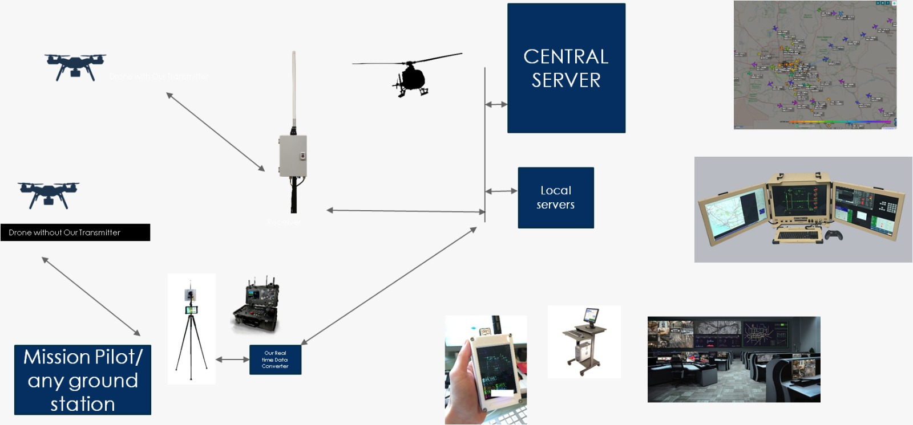

Slide 6

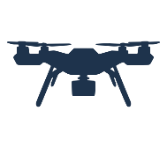

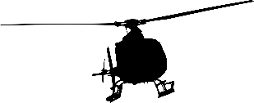
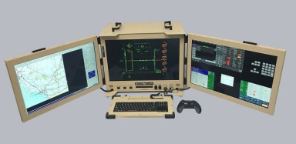
Local servers
CENTRAL SERVER
Input / Output
Devices for Control and Display
Via VPN

Slide 7
Deploying the SDN Architecture
The second step is to deploy the SDN architecture in the area where aircraft and drones are expected to fly. This involves installing the sensors, switches, and servers required for the architecture. The sensors should be placed strategically to provide maximum coverage of the area, and the switches should be configured to forward data to the SDN controller. The servers should be configured to receive and process the data collected by the sensors.

Slide 8
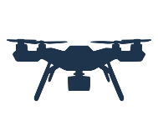
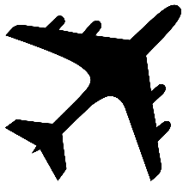
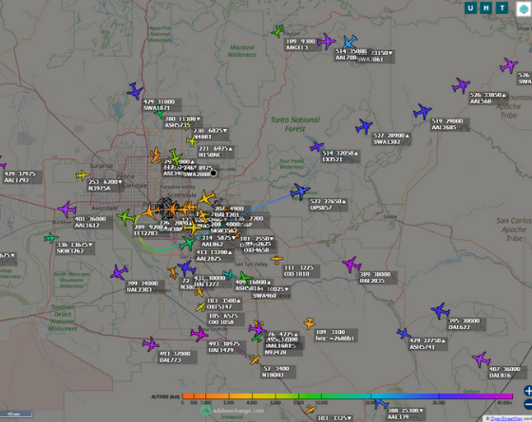
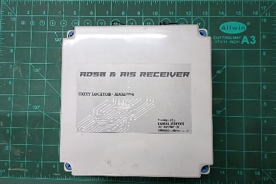
Combined display on any PC or Tablet
Receiver – Receives – Drone data + Aircraft Data + Ships data

Slide 9
Training Machine Learning Models
The third step is to train the machine learning models used by the SDN controller to identify aircraft and drones. The models would be trained using data collected by the sensors during the deployment of the SDN architecture. The models should be trained to accurately classify aircraft and drones based on their size, shape, and flight characteristics.

Slide 10
Monitoring the SDN Architecture
The fourth step is to monitor the SDN architecture to ensure that it is functioning correctly. The SDN controller would be configured to generate alerts if any sensors or switches fail, or if there is any unusual activity detected in the network. The central server or agency would also be able to monitor the data transmitted from the SDN architecture.

Slide 11
Evaluating the SDN Architecture
The final step is to evaluate the SDN architecture to determine its effectiveness in identifying and tracking aircraft and drones. The evaluation would focus on the accuracy of the identification, the speed of data transmission, and the reliability of the system.

Slide 12
Why SDN is a feasible solution
SDN can be used to improve the efficiency and effectiveness of the network infrastructure required for identifying aircraft and drones. The SDN architecture separates the control plane, which is responsible for controlling the behavior of the switches in the network, from the data plane, which is responsible for forwarding data packets. This separation allows the network administrator to control network behavior through a centralized controller, making it easier to manage and configure the network.

Slide 13
Why SDN is a feasible solution
SDN can also be used to improve the performance of the network infrastructure required for identifying aircraft and drones. SDN allows network administrators to define the network policies that control network behavior, which can be optimized for the specific requirements of identifying aircraft and drones. For example, the policies can be designed to prioritize traffic from the sensors that detect and track aircraft and drones, ensuring that this data is transmitted in real-time to the SDN controller.

Slide 14
Why SDN is a feasible solution
SDN can be used to improve the security of the network infrastructure required for identifying aircraft and drones. SDN provides a centralized point of control, making it easier to implement security policies that protect the network from unauthorized access or data breaches. SDN also provides a way to encrypt the data transmitted from the sensors to the central server or agency via a VPN, ensuring that the data is transmitted securely.

Slide 15
Why SDN is a feasible solution
Overall, SDN is an ideal solution for implementing the solution to identify aircraft and drones and transmitting the data to a central server or agency via a VPN. SDN provides a flexible and scalable network infrastructure that can be optimized for the specific requirements of the solution, making it easier to manage, configure, and secure the network.

